Slide 1
Chapter 2
Fundamentals of Digital Image and Spatial Domain Enhancement
2.1 Digital image Representation, Elements of digital image processing systems, sampling and quantization, basic relationships between pixels, mathematical operations on images.
2.2 Spatial domain enhancement techniques: Point processing, Neighborhood processing, spatial domain filtering, zooming.
2.3 Spatial enhancement: Global processing: Histogram Equalization.
Self-Learning Topic: Histogram specification

Slide 2
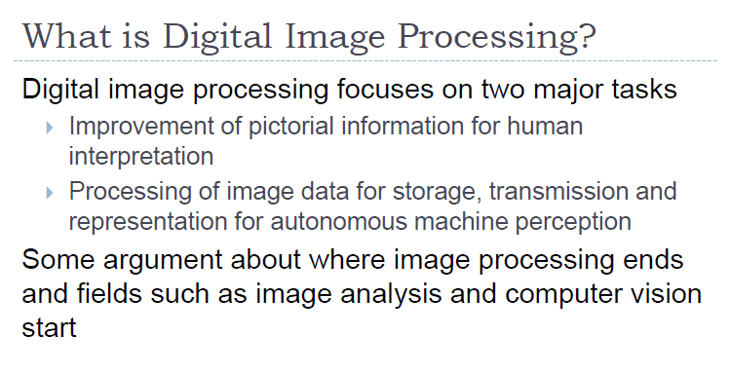

Slide 3
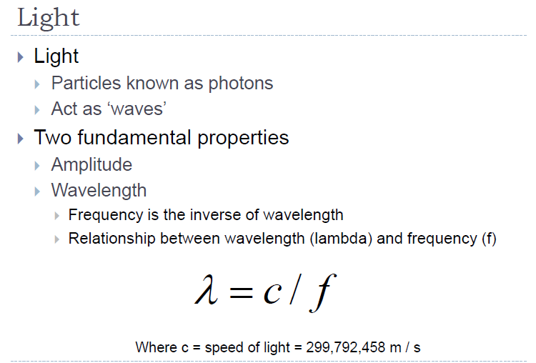

Slide 4
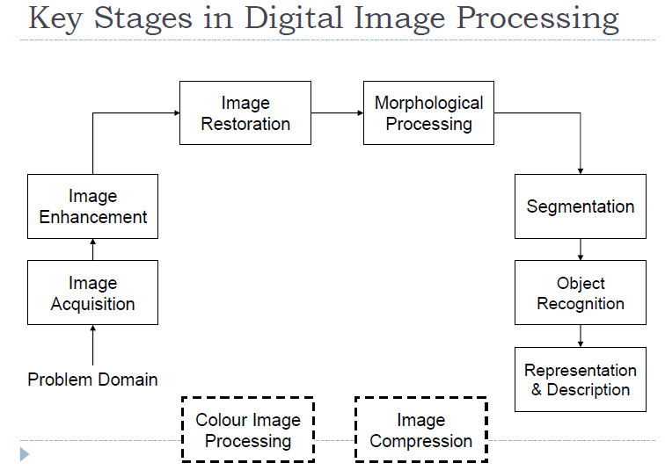

Slide 5
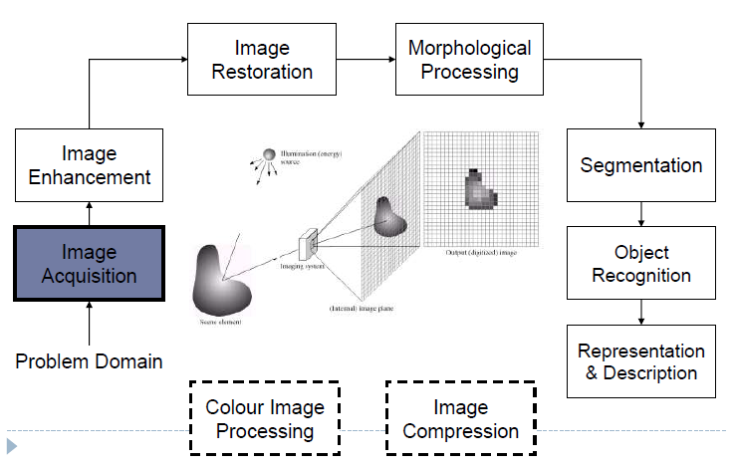

Slide 6
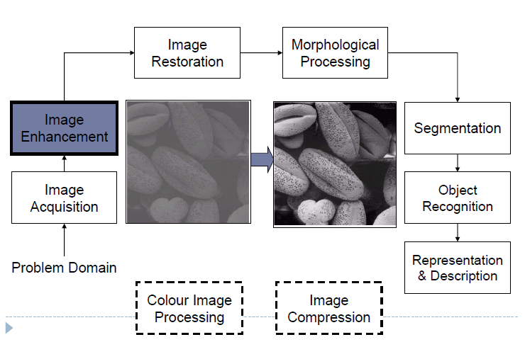

Slide 7
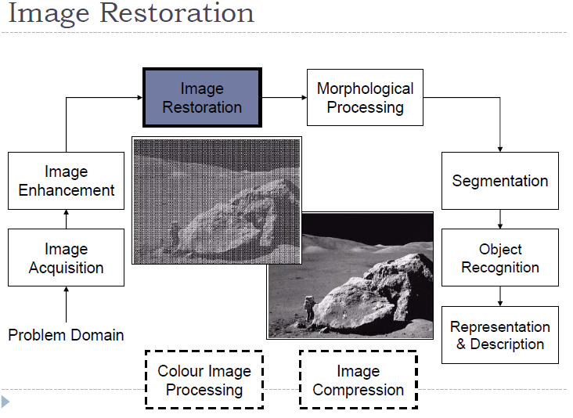

Slide 8
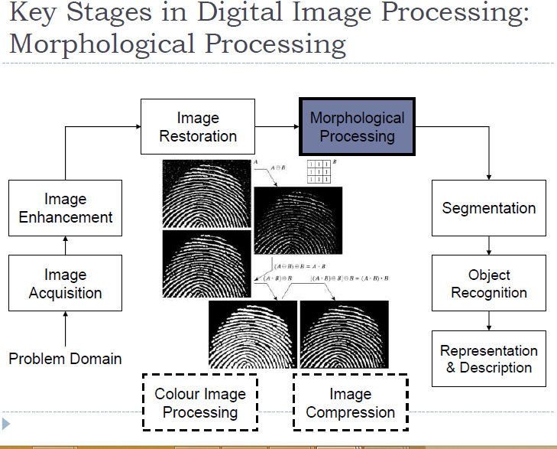

Slide 9
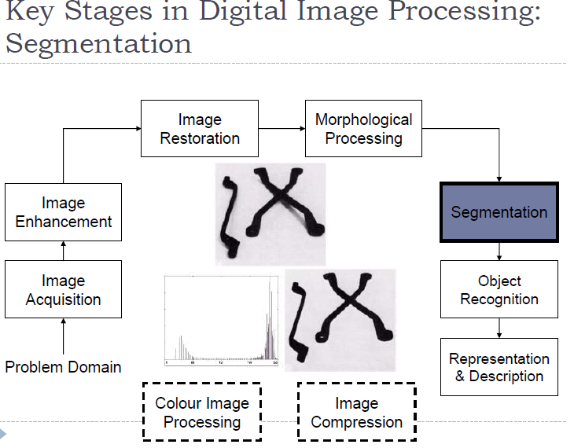

Slide 10
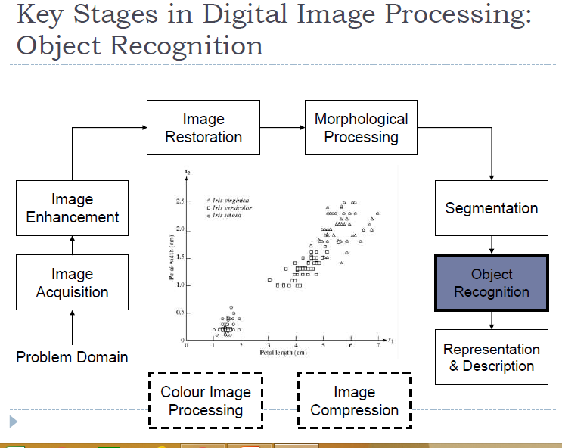

Slide 11
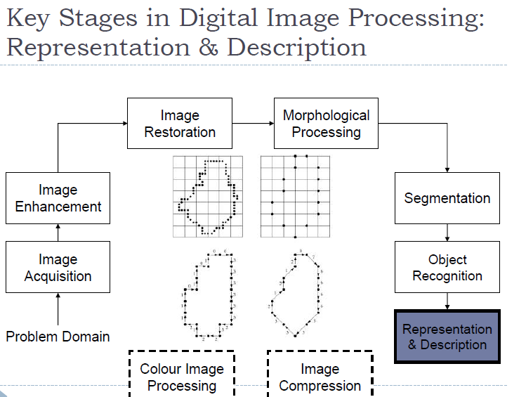

Slide 12
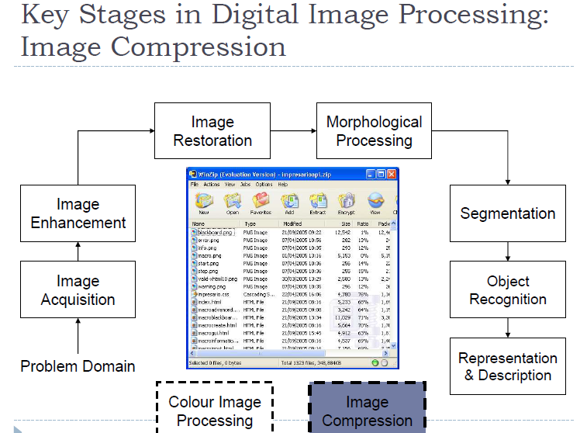

Slide 13
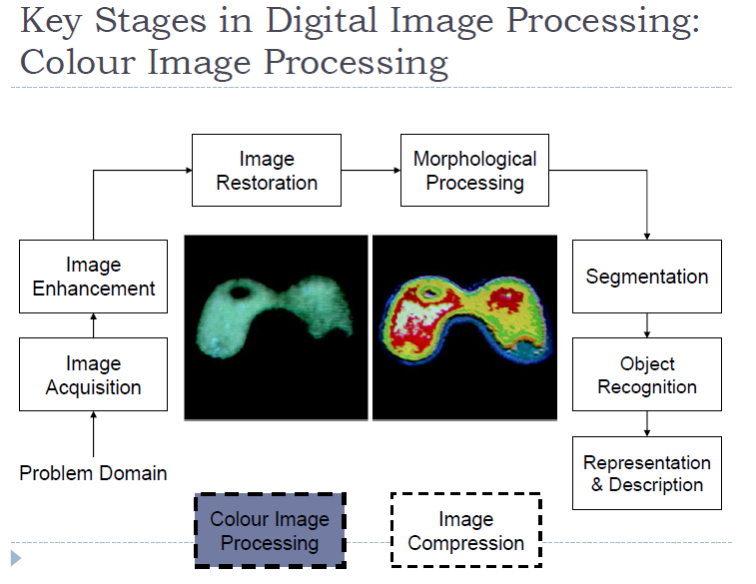

Slide 14
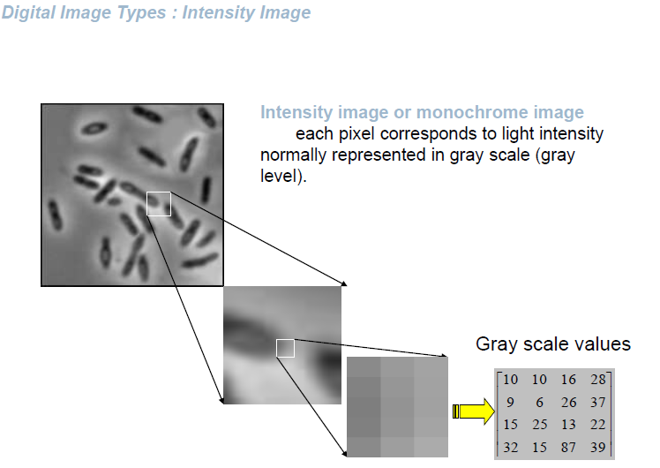

Slide 15
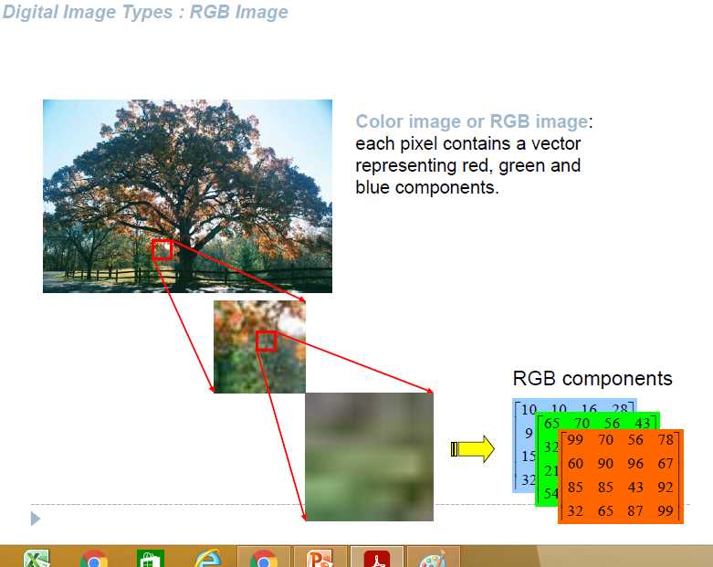

Slide 16
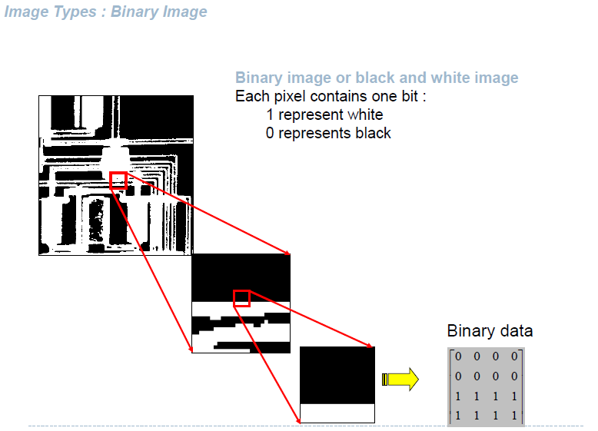

Slide 17
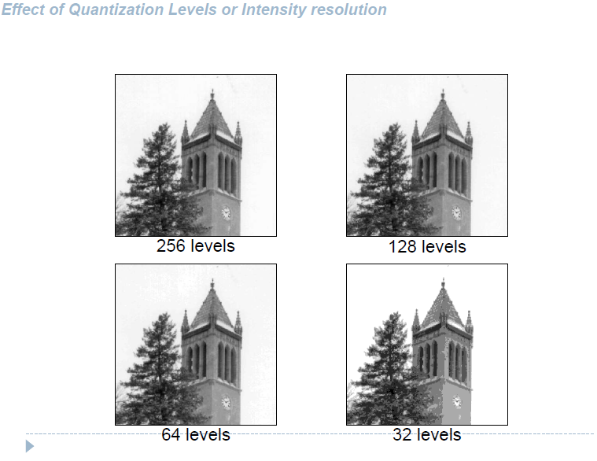

Slide 18
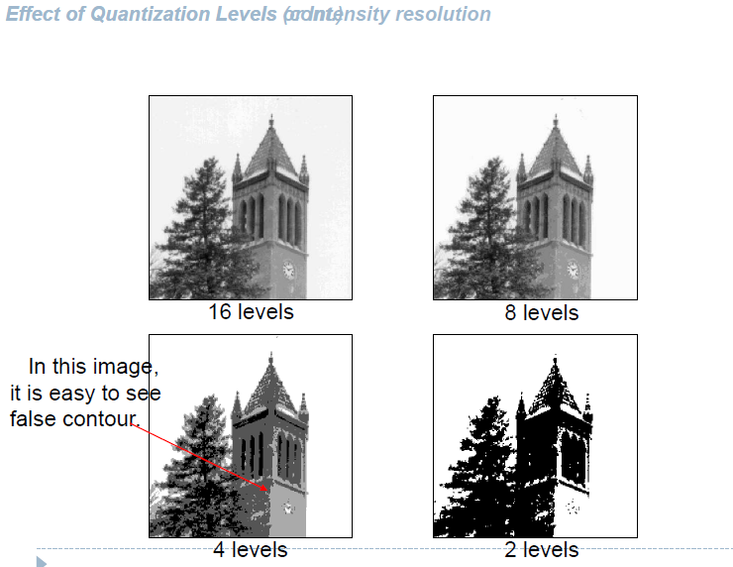

Slide 19
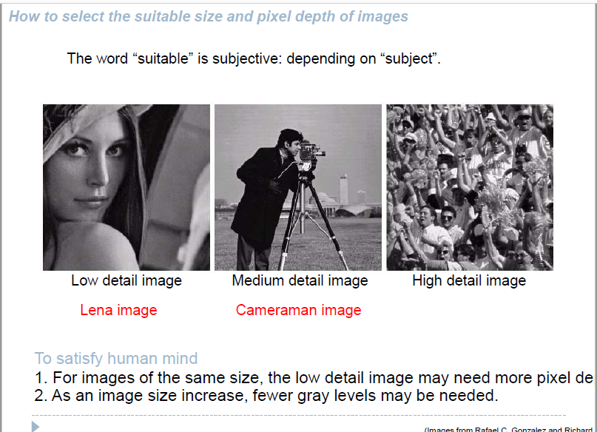

Slide 20

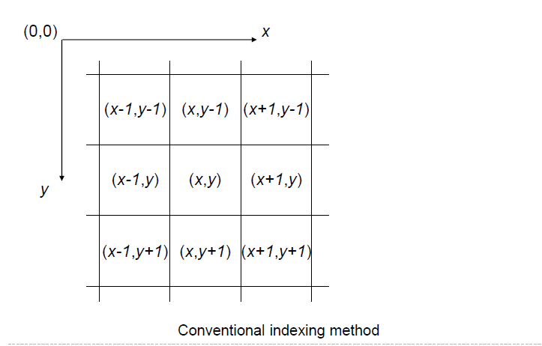

Slide 21
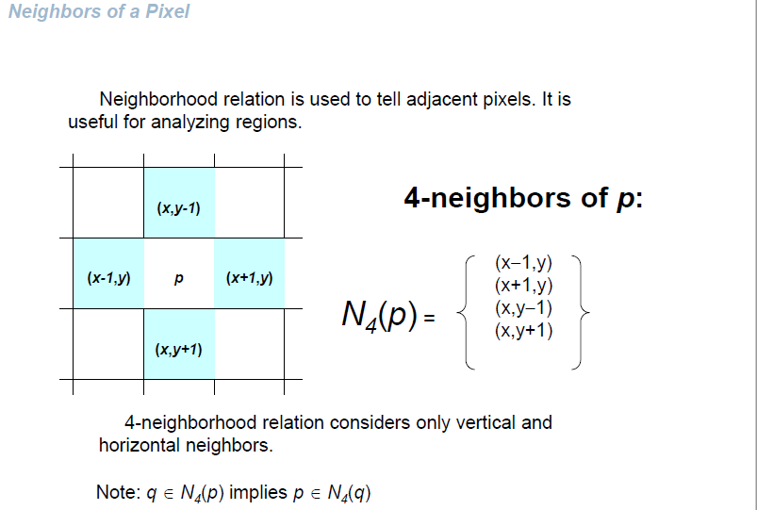

Slide 22
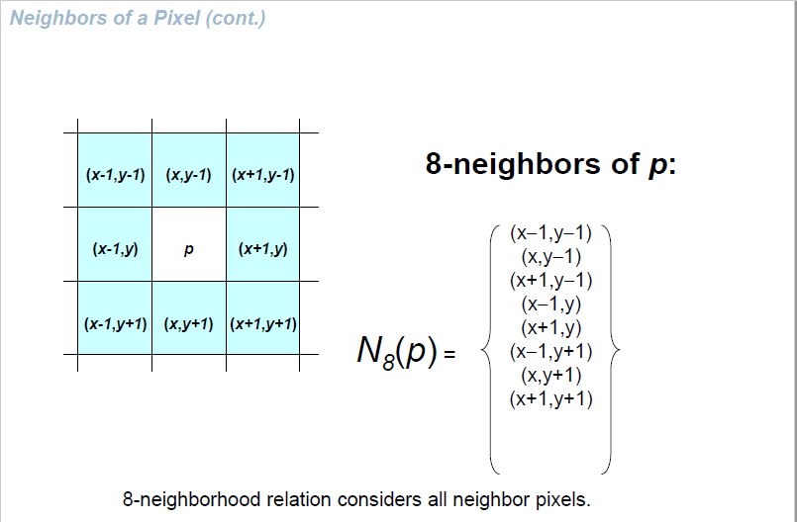

Slide 23
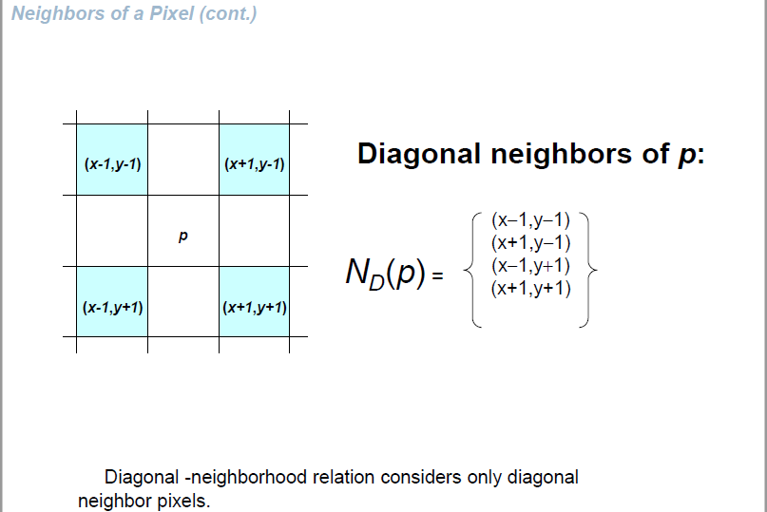

Slide 24
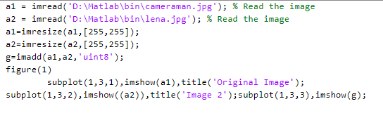
Mathematical Operations on Images
Image Addition

Slide 25
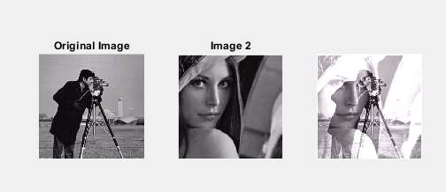

Slide 26
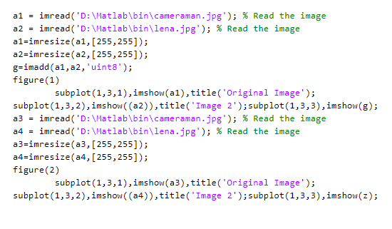
Image Subtraction

Slide 27
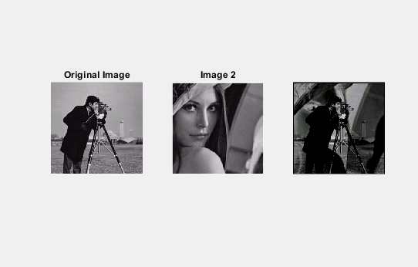

Slide 28
Mathematical Operations on Images
Image Multiplication
G(x,y)=f1(x,y)*f2(x,y)
Image Division
G(x,y)=f1(x,y)/f2(x,y)

Slide 29
Image Enhancement
objective of image enhancement is to improve the interpretability of the information present in images for human viewers.
enhancement algorithm is one that yields a better-quality image for the purpose of some particular application which can be done by either suppressing the noise or increasing the image contrast.

Slide 30
Spatial Domain Methods
Image-enhancement techniques can be classified into two broad categories as
spatial domain method
The spatial domain method operates directly on pixels or raw data.
(2) transform domain method
Transform domain method operates on the Fourier transform of an image and then transforms it back to the spatial domain.

Slide 31
Spatial Domain - Point Processing
Image Negative or Digital Negative
F(x,y) may be an image here F is grey level value(0 to 255).
0 black
255 white
Here x,y represents image coordinates

Slide 32
Spatial Domain - Point Processing
The inverse transformation reverses light and dark.
Application – X-ray image
Inverting grey levels.
g (m, n) = 255 − f (m, n)
Here g (m,n) is negative image
f(m,n) is original image

Slide 33
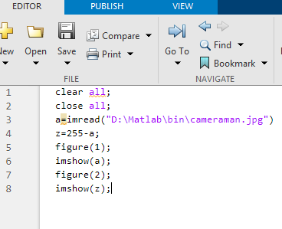

Slide 34
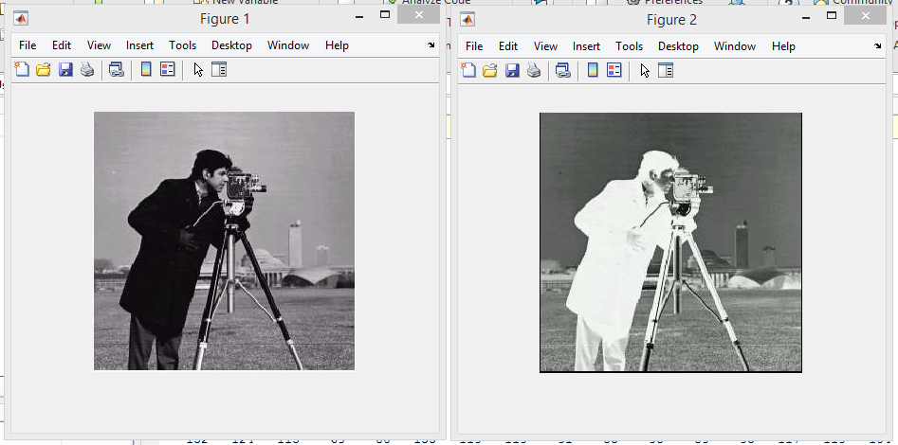

Slide 35
Spatial Domain - Point Processing
2) Contrast Stretching or Contrast Adjustment
Poor illumination images are not clear.
Contrast stretching is increase the contrast of the images by making the dark portions darker and the brighter portions brighter.
Contrast adjustment is done by scaling all the pixels of the image by a constant k. It is given by
g [m, n] = f [m, n] ∗ k

Slide 36
Spatial Domain - Point Processing
Specifying a value above 1 will increase the contrast by making bright samples brighter and dark samples darker.
A value below 1 will do the opposite and reduce a smaller range of sample values.

Slide 37
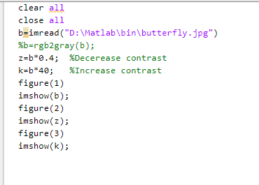

Slide 38
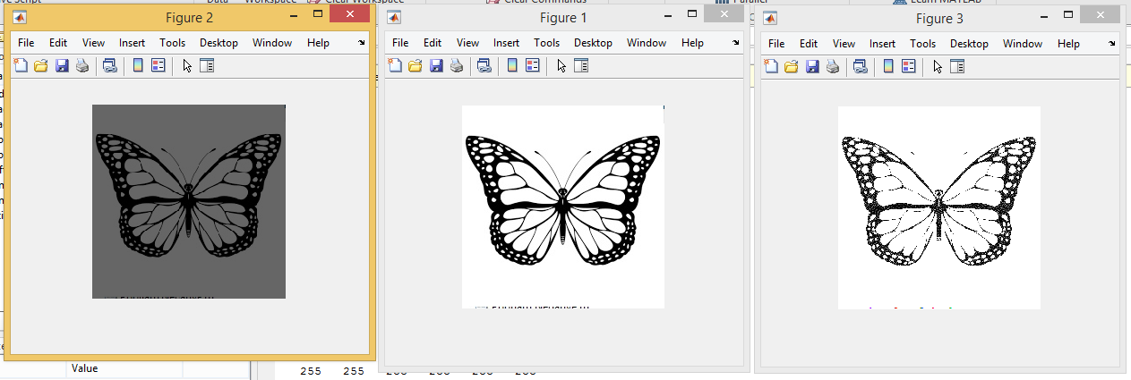

Slide 39
Spatial Domain - Point Processing
3) Thresholding
Extreme contrast stretching yields in thresholding.
S=255; if r(pixel intensity value) >=a (threshold value)
S=0 if r(pixel intensity value) < a(threshold value)

Slide 40
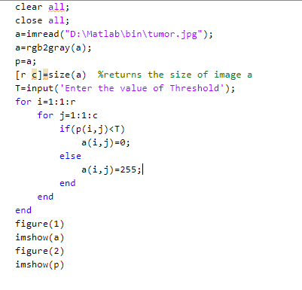

Slide 41
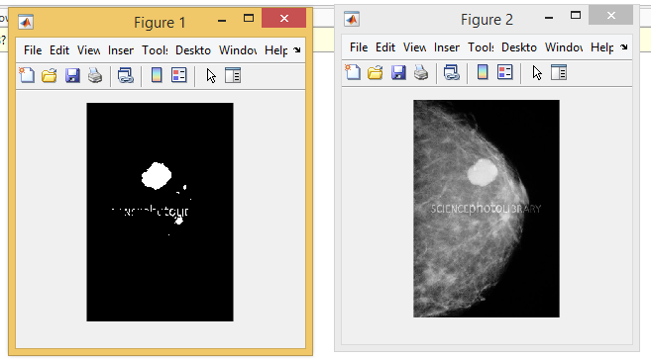

Slide 42
Spatial Domain - Point Processing
4) Grey Level Slicing (Intensity slicing)
Thresholding splits the grey level into two parts.
Highlight specific range of grey values we use grey level slicing. Useful for highlighting features in an image
Band of grey level is selected.

Slide 43
Spatial Domain - Point Processing
Grey Level without Background
S=255; if a(low threshold value) <=r(pixel intensity value) <= b(high threshold value)
S=0; otherwise
display a high value for all gray levels in the range of interest and a low value for all other gray levels.
Grey Level with Background
S=255; if a(low threshold value) <=r(pixel intensity value) <= b(high threshold value)
S=r; otherwise
based on the transformation brightens the desired range of gray levels but preserves gray levels unchanged.

Slide 44
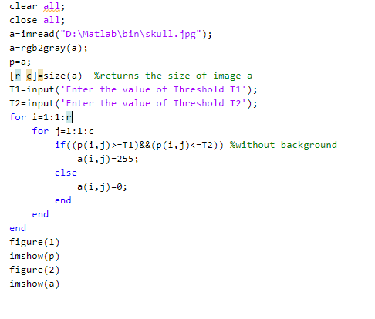

Slide 45
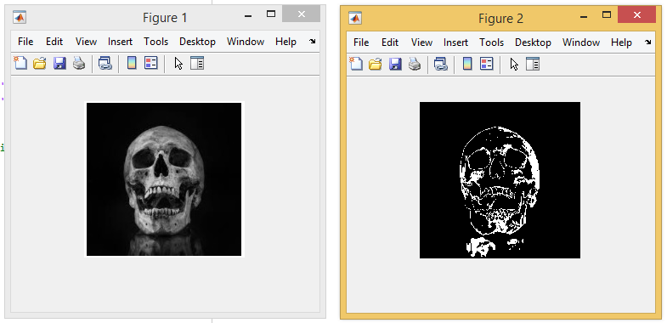

Slide 46
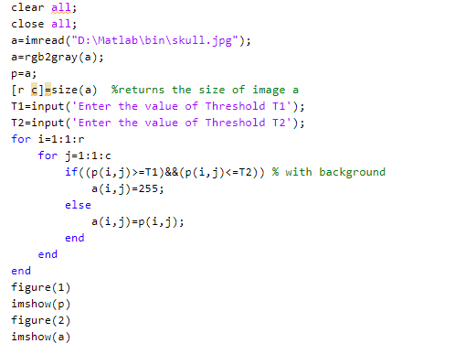

Slide 47
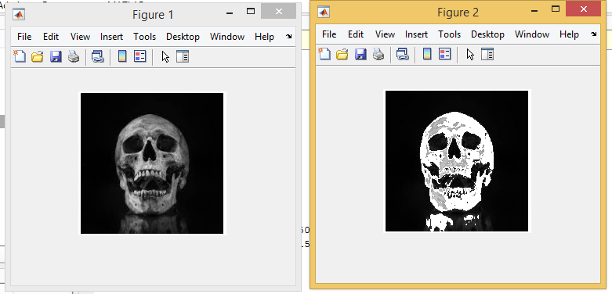

Slide 48
Spatial Domain - Point Processing
5) Bit Plane Slicing
Pixels are digital numbers, each one composed of bits. Instead of highlighting gray-level range, we could highlight the contribution made by each bit.
This method is useful and used in image compression.

Slide 49
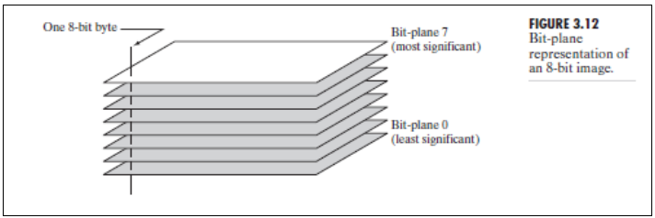
Spatial Domain - Point Processing

Slide 50
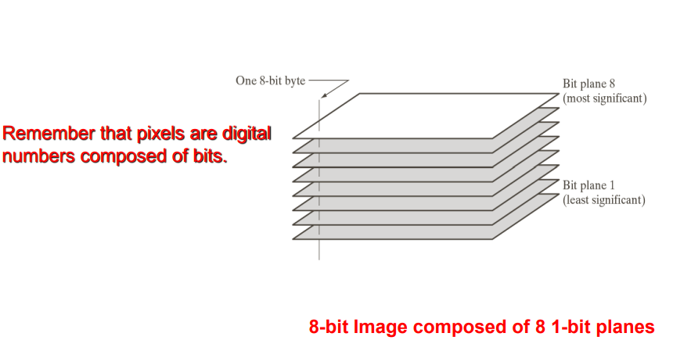

Slide 51
Spatial Domain - Point Processing
Often by isolating particular bits of the pixel values in an image we can highlight interesting aspects of that image.
– Higher -order bits usually contain most of the significant visual information.
– Lower -order bits contain subtle details.

Slide 52
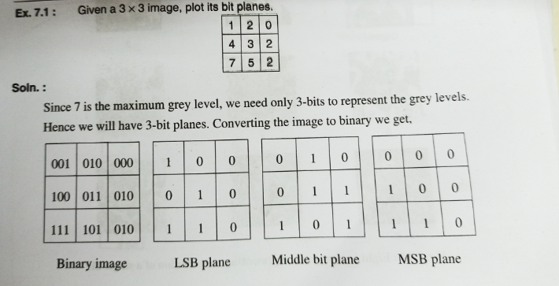
Spatial Domain - Point Processing

Slide 53
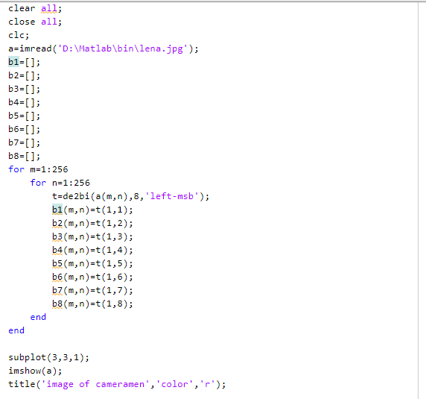

Slide 54
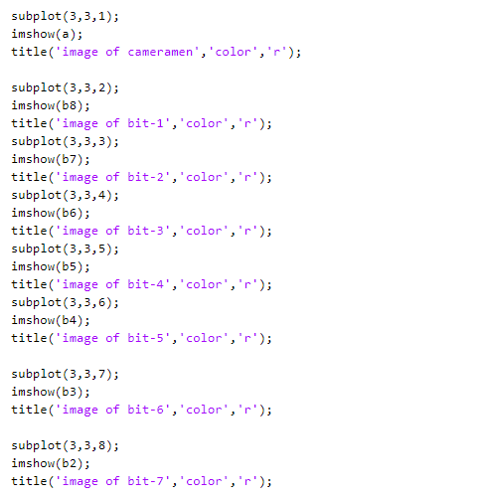

Slide 55
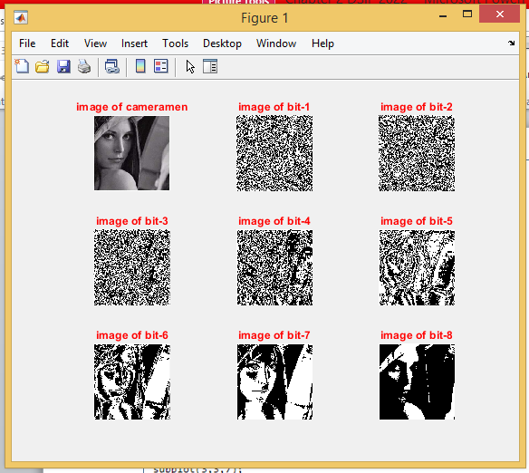

Slide 56
Spatial Domain - Point Processing
6) Dynamic Range Compression (Log Transformation)
Dynamic range of the image exceeds the capability of the display device.
Some pixel values are so high that low pixel values get over shadowed.
To be able to see the small value pixels dynamic range compression is used.

Slide 57
Spatial Domain - Point Processing
Log operator being the excellent compressing function.
Dynamic range compression is achieved by using log operator.
Log Transformation = C*log(1+|a|)…(a=image)

Slide 58
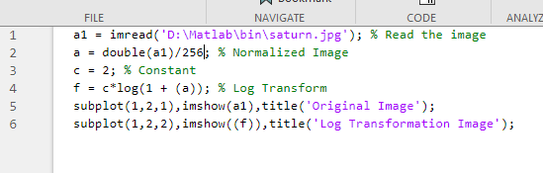

Slide 59
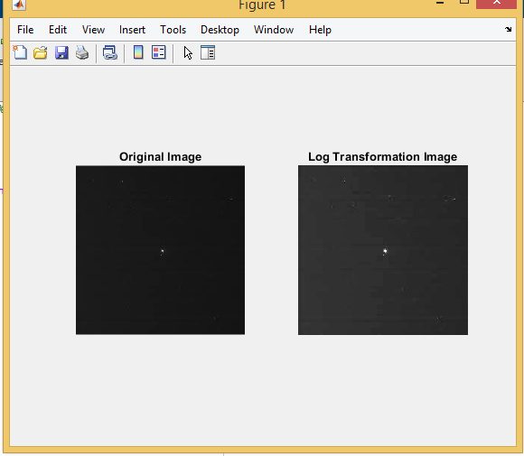

Slide 60
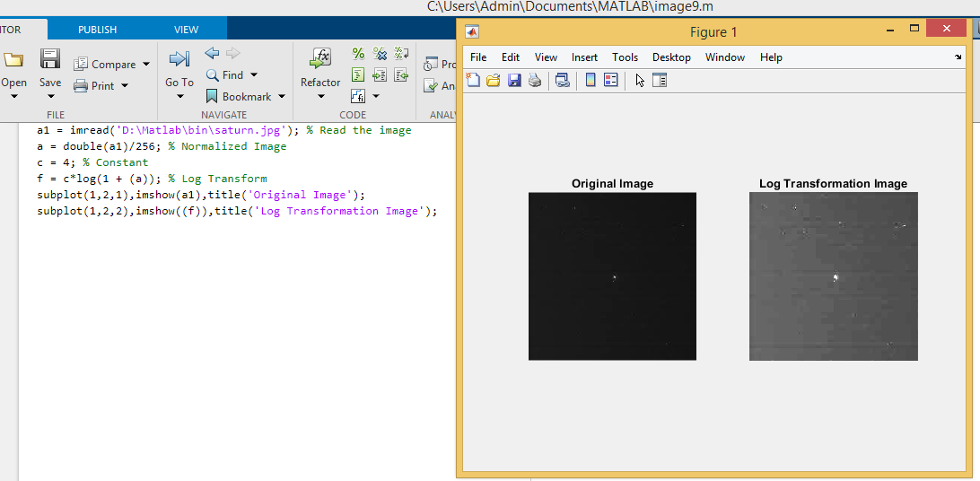

Slide 61
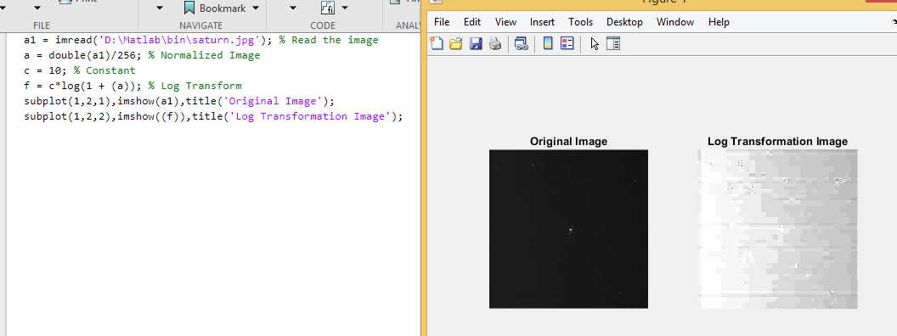

Slide 62
Spatial Domain - Point Processing
7) Power Law Transformation
human perception of brightness - more sensitive to changes in dark as compared to bright.
display devices like computer screen have Intensity to voltage (non linear) - which is a power function with exponents(Gamma) varying from 1.8 to 2.5.
any input signal(say from a camera), the output will be transformed by gamma because of non-linear intensity to voltage relationship of the display screen - This results in images that are darker than intended.

Slide 63
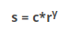
Spatial Domain - Point Processing
we apply gamma correction to the input signal.
This input cancels out the effects generated by the display and we see the image as it is.

Slide 64
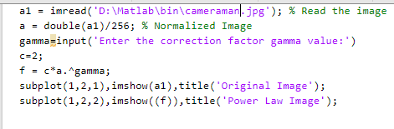

Slide 65
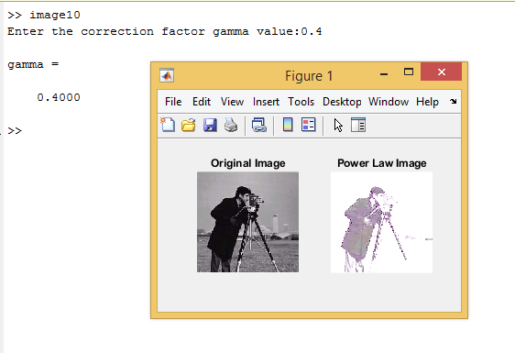

Slide 66
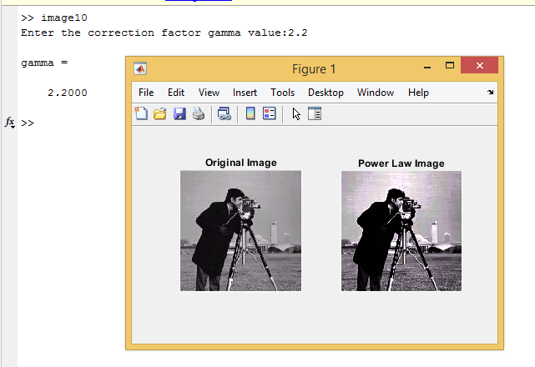

Slide 67
Neighbourhood Processing
In neighbourhood operation, the pixels in an image are modified based on some function of the pixels in their neighbourhood.
Instead of 3*3 neighbourhood , we could also use 5*5 or a 7*7 …….

Slide 68
Low Pass Averaging Filter (Box Filter)
If an image has Gaussian noise present in it a low pass averaging filter is used to eliminate it.
The mean filter replaces each pixel by the average of all the values in the local neighbourhood.
The size of the neighbourhood controls the amount of filtering.

Slide 69
Low Pass Averaging Filter
spatial averaging operation, each pixel is replaced by a weighted average of its neighbourhood pixels.
The low-pass filter preserves the smooth region in the image and it removes the sharp variations leading to blurring effect.

Slide 70

Low Pass Averaging Filter

Slide 71
Low Pass Averaging Filter
It is to be noted that the sum of the elements is equal to 1 in the case of a low-pass spatial mask.
The blurring effect will be more with the increase in the size of the mask.
the size of the mask will be odd so that the central pixel can be located exactly.

Slide 72


Slide 73


Slide 74
Low Pass Averaging Filter
Low frequency regions remain unchanged while sharp edges become blur.
Grey level transition from 10 to 50 reduces to 10 -23.33 -36.6-50 blurring effect.

Slide 75
Low Pass Averaging Filter
Limitations of Averaging Filter
1. Averaging operation leads to the blurring of an image. Blurring affects feature localisation.
2. If the averaging operation is applied to an image corrupted by impulse noise then the impulse noise is attenuated and diffused but not removed.
3. A single pixel with unrepresentative value can affect the mean value of the centre pixel.

Slide 76

Low Pass Averaging Filter

Slide 77

Weighted Average Filter
The mask of a weighted average filter is given by
the pixels nearest to the centre are weighted more than the distant pixels

Slide 78
Weighted Average Filter
In the mask the pixel at the center of the mask is multiplied by a higher value than any other, thus giving this pixel more importance in the calculation of the average.

Slide 79

Median Filter
Median filters are statistical non linear filters in spatial domain.
Median filter smoothens the image by utilising the median of the neighbourhood.
Steps performed by median filter to find each pixel value in processed image:

Slide 80


Median Filter

Slide 81



Slide 82


Slide 83



Slide 84
Median Filter
When we take the median value, the pixel values which are very different from their neighbouring pixels are replaced by a value equal to the neighbouring pixel value.
median filter is capable of reducing salt-and-pepper noise.
A median filter is an effective tool to minimise salt-and-pepper noise.

Slide 85


Slide 86


Slide 87


Slide 88

Gaussian Filter
Gaussian filters are a class of linear smoothing filters with the weights chosen according to the shape of a Gaussian function.
The Gaussian kernel is widely used for smoothing purpose.
2 Dimensional gaussian function

Slide 89
Gaussian Filter
Gaussian smoothing is a particular class of averaging, in which the kernel is a 2D Gaussian.
Properties of Gaussian Filter:
Gaussian functions are rotationally symmetric in two dimensions. The meaning of the term ‘rotationally symmetric’ is that the amount of smoothing performed by the filter will be the same in all directions.
The Fourier transform of a Gaussian function is itself a Gaussian function. The Fourier transform of a Gaussian has a single lobe in the frequency spectrum. The single lobe in the Fourier transform of a Gaussian means that the smoothened image will not be corrupted by contributions from unwanted high-frequency signals.
The degree of smoothening is governed by variance σ. A larger σ implies a wider Gaussian filter and greater smoothening.

Slide 90


Slide 91
Highpass Filtering
High pass filtering eliminates the low frequency regions while retaining or enhancing the high frequency components.
High pass image will have no background as it’s a low frequency region.
The main aim of image sharpening is to highlight fine details in the image.
Image sharpening is used to enhance the high-frequency components.

Slide 92

Highpass Filtering

Slide 93
Highpass Filtering
Sum of coefficients of high pass mask has to be zero to eliminate the low frequency regions.

Slide 94


Slide 95


Slide 96
High-boost Filtering
High-boost filter is also known as a high-frequency emphasis filter.
A high-boost filter is used to retain some of the low-frequency components(background) to aid in the interpretation of an image.
In high-boost filtering, the input image f(m, n) is multiplied by an amplification factor A before subtracting the low-pass image.

Slide 97

High-boost Filtering
High pass filter gets rid of the complete background.
Thus, the high-boost filter expression becomes A is amplification factor

Slide 98

HBF Mask
A or K amplification factor

Slide 99
Zooming
When an image has fine details, it may not be possible to examine the detail easily in a standard display on a monitor.
zooming operation helps to view fine details in the image.
Zooming is equivalent to holding a magnifying glass in front of the screen.
The simplest zooming operation is through ‘replication’ of pixels.

Slide 100


Slide 101


Slide 102
Histogram Modelling
Histogram of images provides global description of the appearance of an image.
Histogram of an image represents the relative frequency of occurrence of the various grey levels in an image.

Slide 103

Histogram Modelling
Two methods of plotting histogram.

Slide 104

Histogram Modelling

Slide 105
Histogram Modelling
Histogram plotted in the second method is normalised histogram.
Maximum value to be plotted will be 1.
Normalised histogram provides clear information about the image.

Slide 106
Linear Stretching
Histogram stretching is one way to increase dynamic range of the image.
Here the basic shape of the histogram is not altered , instead the histogram is spread to cover the entire dynamic range.

Slide 107



Slide 108
Histogram Equalization
Equalisation is a process that attempts to spread out the gray levels in an image so that they are evenly distributed across their range.
Histogram equalisation reassigns the brightness values of pixels based on the image histogram.
Histogram equalisation is a technique where the histogram of the resultant image is as flat as possible.

Slide 109

Histogram Equalization
Histogram equalisation provides more visually pleasing results across a wider range of images.

Slide 110


Slide 111


Slide 112


Slide 113


Slide 114


Slide 115


Slide 116


